Slide 1


Juhi Ameta
Sept 15,2023

Slide 2

Outline
Executive Summary
Introduction
Methodology
Results
Conclusion
Appendix

Slide 3
Executive Summary
This project aims to find out whether Space X Falcon 9 rocket will land successfully.​
The objectives of the project are:​
Understand and collect data.​
Analyze the data, perform visualization.​
Apply Machine Learning algorithms i.e. perform Predictive Analytics, compare the performance of various algorithms.​

Slide 4
Introduction
The project aims to predict if the Falcon 9 first stage will land successfully. SpaceX advertises Falcon 9 rocket launches on its website, with a cost of 62 million dollars; other providers cost upward of 165 million dollars each, much of the savings is because SpaceX can reuse the first stage. Therefore if we can determine if the first stage will land, we can determine the cost of a launch. This information can be used if an alternate company wants to bid against SpaceX for a rocket launch.
As a Data Science project, the overall process followed begins with data collection stage, further to exploratory data analysis, data visualization, applying machine learning algorithms to make predictions and evaluation of the moedl developed.

Slide 5

Section 1

Slide 6
Methodology
Executive Summary
Data collection methodology:
The data has been collected using SpaceX REST API and Web Scrapping from Wikipedia.
Perform data wrangling
The column outcome in data represents whether the first stage landed successfully.
Perform one hot encoding, handling null values.
Perform exploratory data analysis (EDA) using visualization and SQL
This step tries to gain insights from data, perform Feature Engineering from Database.

Slide 7
Methodology
Executive Summary
Perform interactive visual analytics using Folium and Plotly Dash
Interactive Visualization techniques include features for zoom in/out, filter, search, identify patterns faster, etc. The first part includes analysis of Launch Site Data with Folium, and the second part builds a dashboard with Dash.
Perform predictive analysis using classification models
This step applies the machine learning algorithms to perform Predictive Analysis. The goal is to classify whether the launch is successful or not.
Split the data into train and test set, apply standardization (feature scaling), apply SVM, Decision trees, Logistic Regression algorithms, apply Grid Search for best parameters, predict on test data.

Slide 8
Data Collection
Data Collection Process involves extraction from two sources-
1. SpaceX REST API 2.Web Scraping from Wikipedia
First method involves getting a response from SpaceX API using get method and converting into json file, apply json_normalize to convert to dataframe, perform data cleaning and export to a csv file.
Second method involves getting a response using get method, create a BeautifulSoup object, finding tables, getting column names, create a dictionary, append data to keys of dictionary, converting the dictionary to dataframe, and export to csv file.

Slide 9
Data Collection
SpaceX REST API
Returns data in JSON format
Normalize into CSV file
Ready for Data Cleaning
HTML Response from Wikipedia
Extract data using Beautifulsoup
Normalize into CSV file

Slide 10
Data Wrangling
The goal of Data Wrangling is to find out the null values in the data and prepare the data for further processing.
For ex there are multiple mission outcomes- True Ocean means the mission outcome was successfully landed to a specific region of the ocean while False Ocean means the mission outcome was unsuccessfully landed to a specific region of the ocean.

Slide 11
Data Wrangling
Identify Null Values
Calculate the number of launches on each site
Calculate the number of occurrence of each orbit
Create landing outcome label from outcome column
Calculate the number of occurrence of mission outcome per orbit

Slide 12
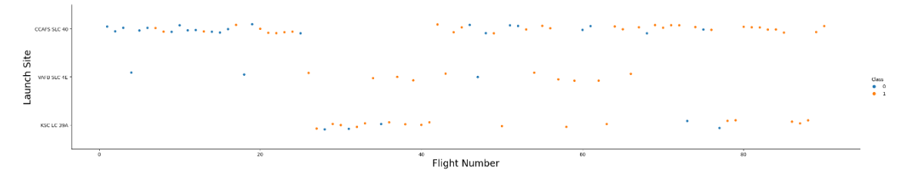
EDA with Data Visualization
Exploratory Data Analysis step deals with in depth analysis of data, finding out relationship among the various variables and perform feature engineering.
A simple scatter plot to show the relationship between Flight Number and Launch Site.

Slide 13
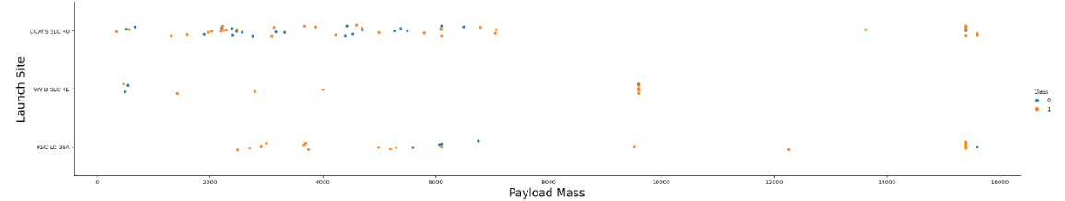
EDA with Data Visualization
The plot between Payload Mass and Launch Site features shows that VAFB-SLC Launch site, there are no rockets launched for heavy payloadmass i.e. > 10000.
Github URL- https://github.com/JATRIVEDI/Course-10-CapstoneProject/blob/main/Exploring-and-preparing-data.ipynb

Slide 14
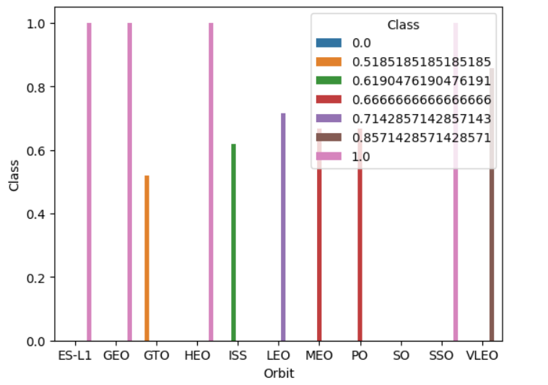
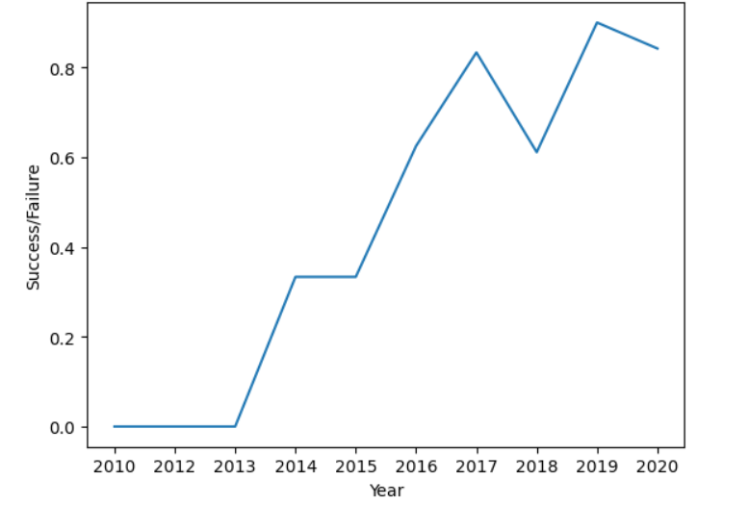
EDA with Data Visualization
Bar Chart between Success Rate and Orbit Type
A plot between year and success rate shows success rate kept increasing since 2013 till 2020.

Slide 15
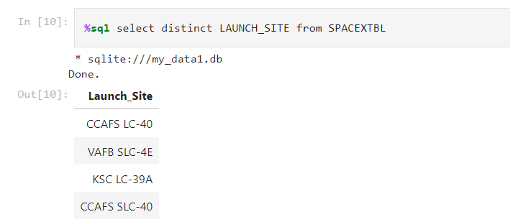
EDA with SQL
Download the database
Connect to the database using %load_ext, %sql commands.
Display the names of unique launch sites.
Github URL - https://github.com/JATRIVEDI/Course-10-CapstoneProject/blob/main/jupyter-labs-eda-sql-coursera_sqllite.ipynb

Slide 16
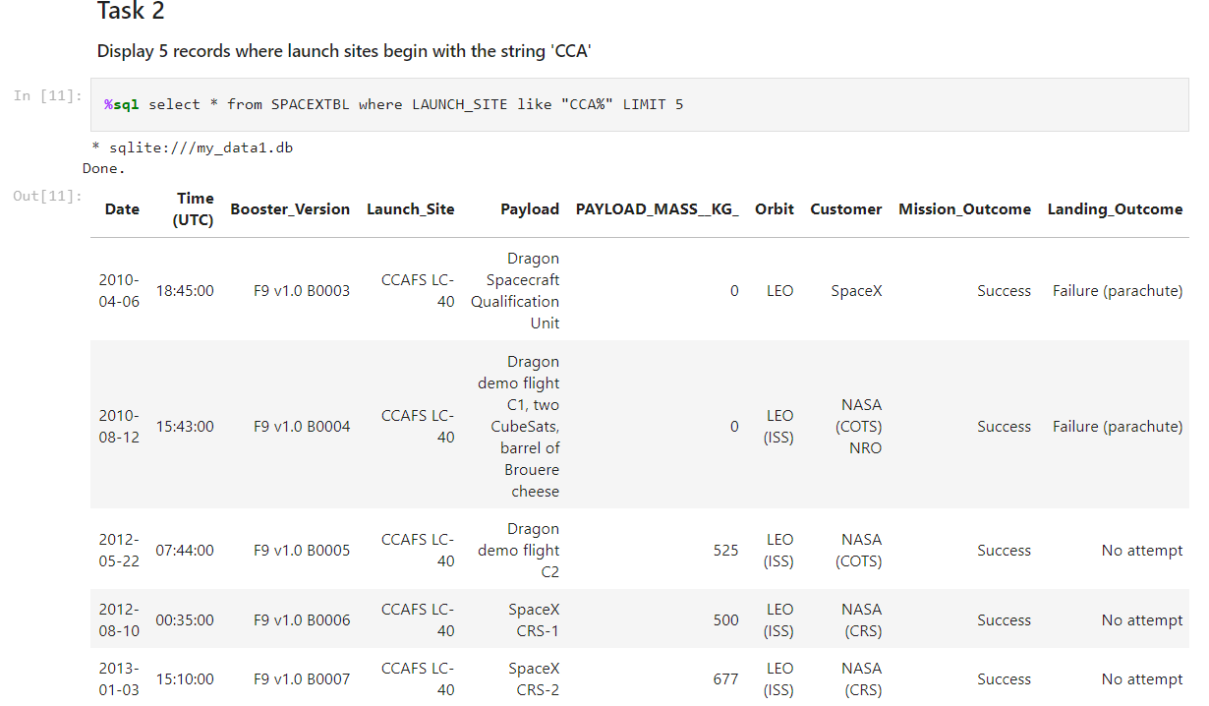
EDA with SQL
Display 5 records where launch sites begin with the string 'CCA'

Slide 17
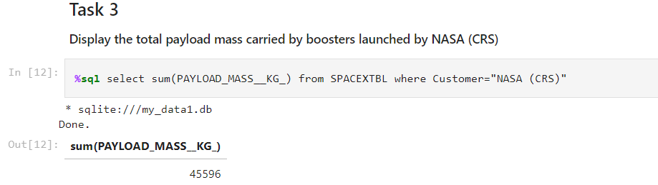
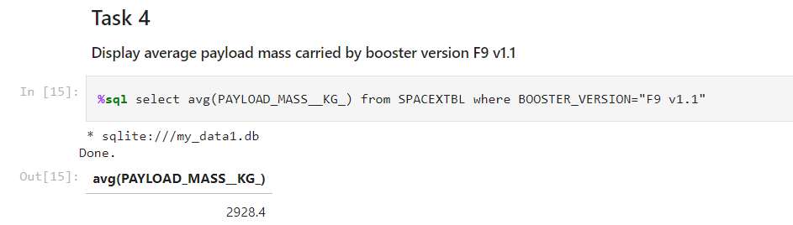
EDA with SQL
Display the total payload mass carried by boosters launched by NASA (CRS)
Display average payload mass carried by booster version F9 v1.1

Slide 18
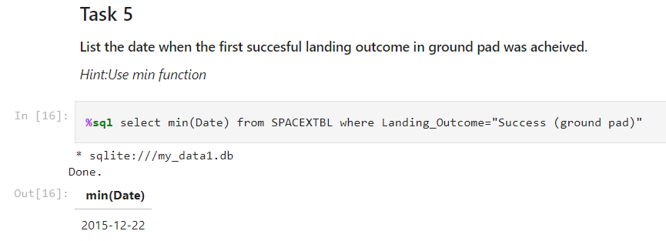
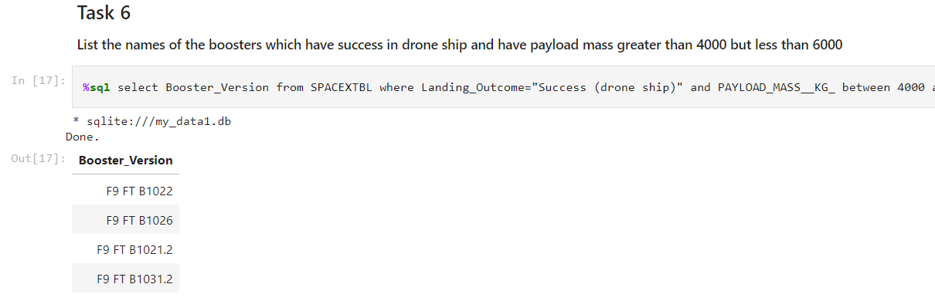
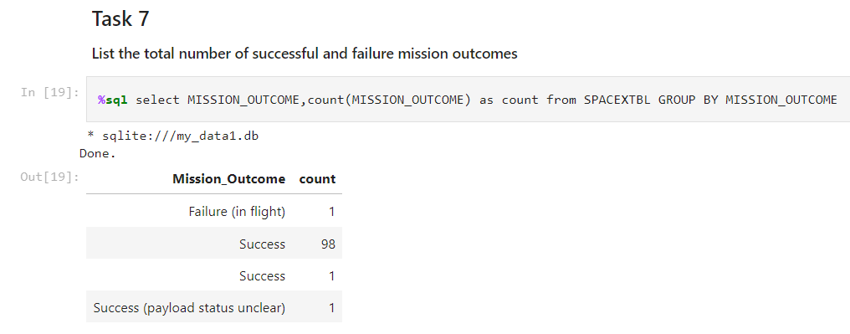
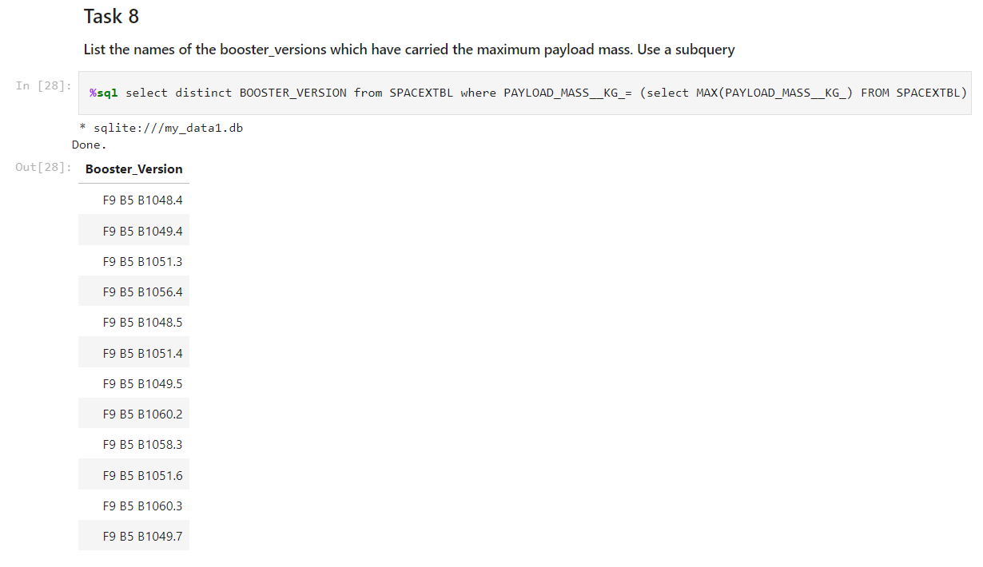
EDA with SQL

Slide 19
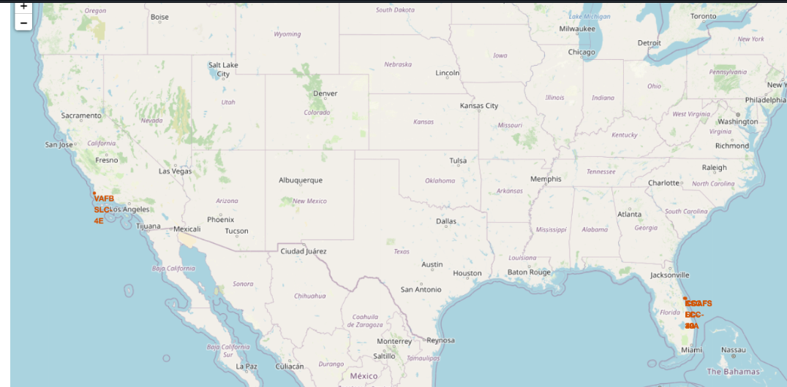
Build an Interactive Map with Folium
Interactive Visual Analytics can be done with Folium.
We need to import various plugins from Folium library, like- FoliumCluster, MousePosition, etc.
https://github.com/JATRIVEDI/Course-10-CapstoneProject/blob/main/IBM-DS0321EN-SkillsNetwork_labs_module_3_lab_jupyter_launch_site_location.jupyterlite.ipynb

Slide 20
Predictive Analysis (Classification)
Predictive analytics begins with splitting the data into training and test sets.
Various Classification Models (Algorithms) like KNN, Logistic Regression, Decision Trees are applied.
Hyperparameter Tuning is applied using Grid Search to find out the best parameters.
Successive Evaluation of the system.
Github URL- https://github.com/JATRIVEDI/Course-10-CapstoneProject/blob/main/IBM-DS0321EN-SkillsNetwork_labs_module_4_SpaceX_Machine_Learning_Prediction_Part_5.jupyterlite.ipynb

Slide 21
Results
Different launch sites have different success rates. CCAFS LC-40, has a success rate of 60 %, while KSC LC-39A and VAFB SLC 4E has a success rate of 77%.
For the VAFB-SLC launchsite there are no rockets launched for heavypayload mass(greater than 10000).
Orbits ES-L1, GEO, HEO, SSO have higher success rates.
In the LEO orbit the Success appears related to the number of flights.
The success rate since 2013 kept increasing till 2020.
SVM, KNN, Logistic Regression and Decision Trees- all work well in terms of test accuracy.

Slide 22
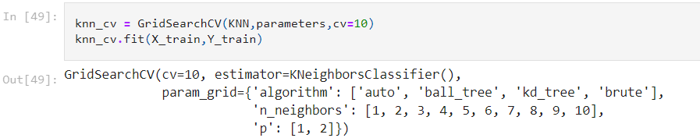
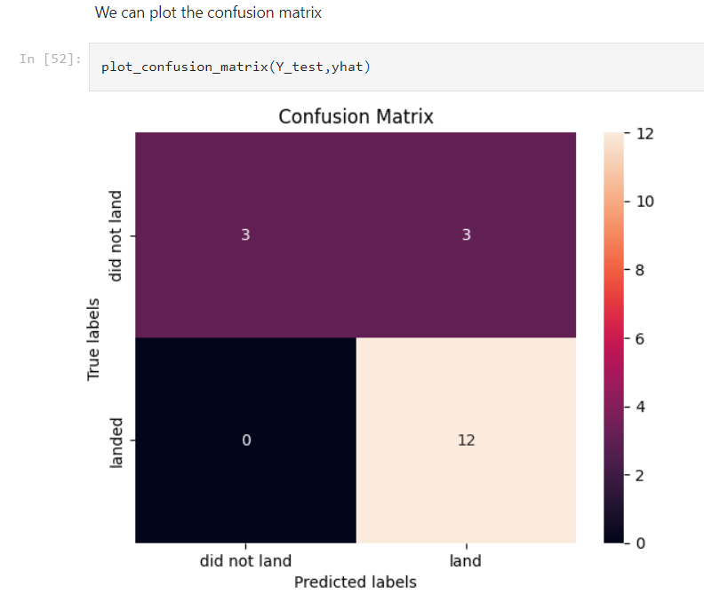
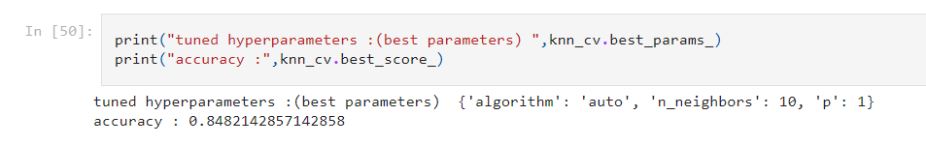
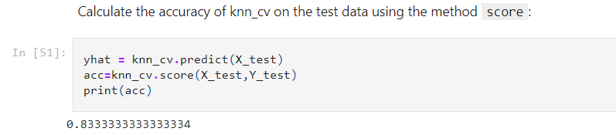
Results
Snippet of KNN Model (Hyperparameter Tuning applied, cv=10)

Slide 23

Section 2

Slide 24
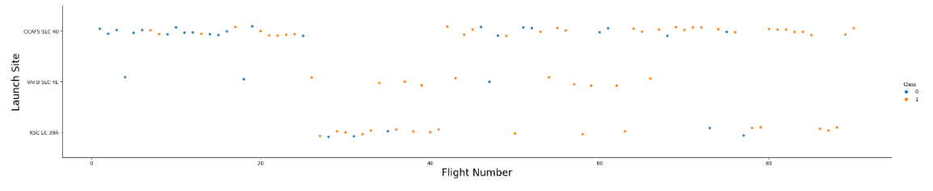
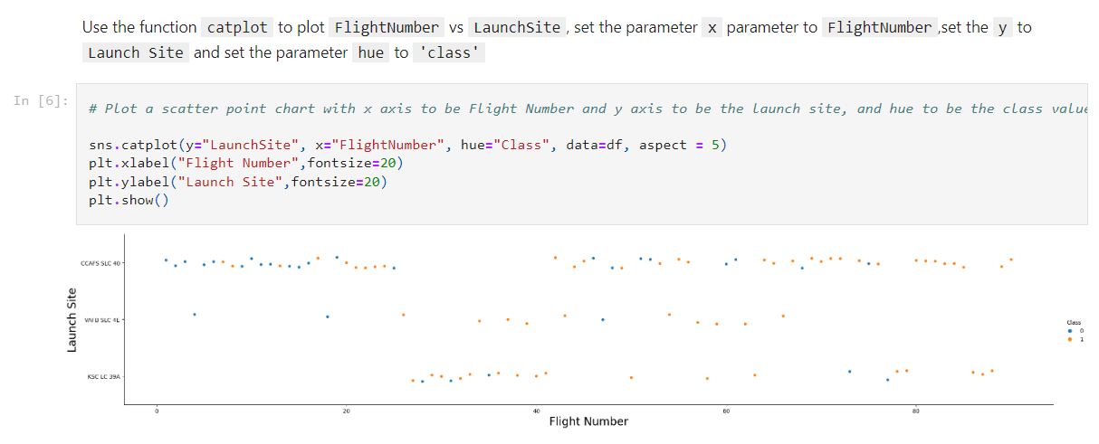
Flight Number vs. Launch Site
Show a scatter plot of Flight Number vs. Launch Site
Show the screenshot of the scatter plot with explanations

Slide 25
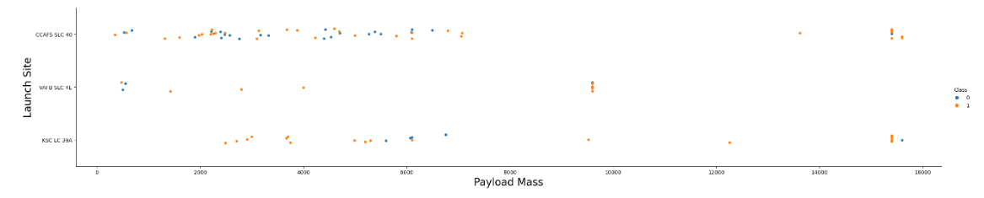
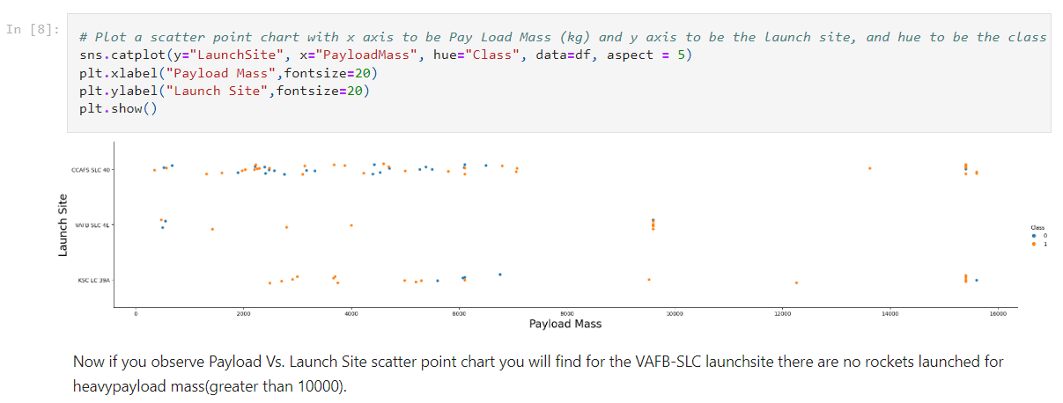
Payload vs. Launch Site
Show a scatter plot of Payload vs. Launch Site
Show the screenshot of the scatter plot with explanations

Slide 26
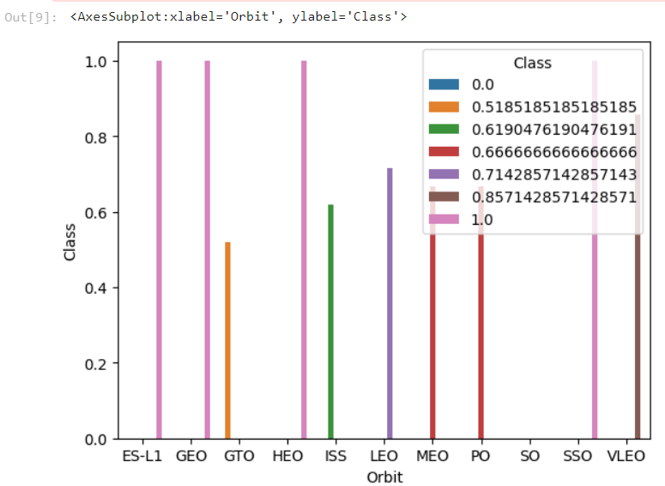
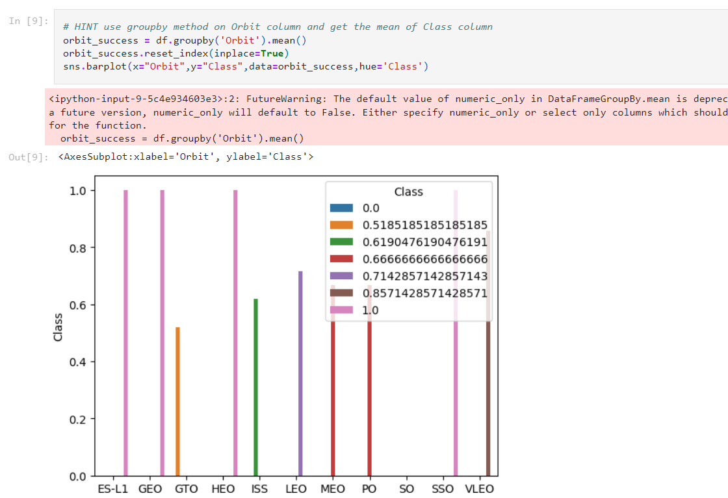
Success Rate vs. Orbit Type
Show a bar chart for the success rate of each orbit type
Show the screenshot of the bar chart with explanations
Orbits ES-L1, GEO, HEO and SSO have higher success rates.

Slide 27
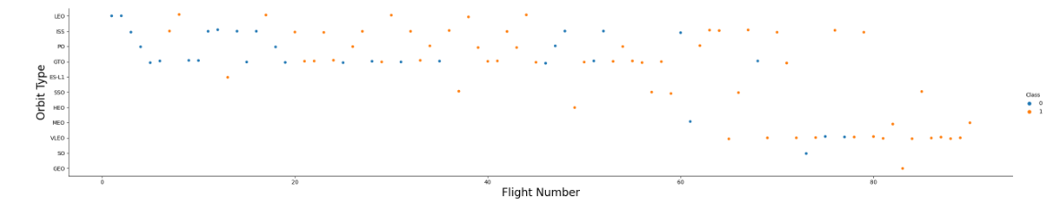
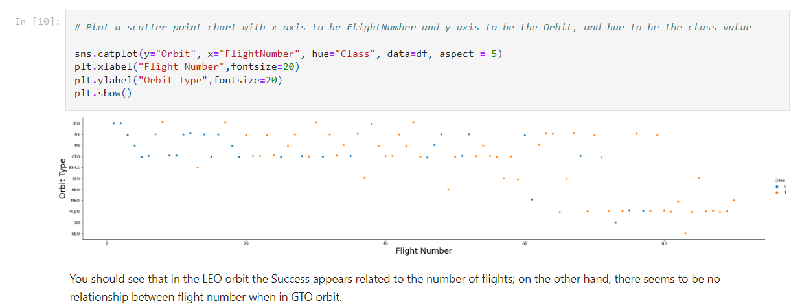
Flight Number vs. Orbit Type
Show a scatter point of Flight number vs. Orbit type
Show the screenshot of the scatter plot with explanations

Slide 28
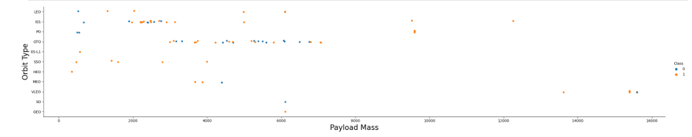
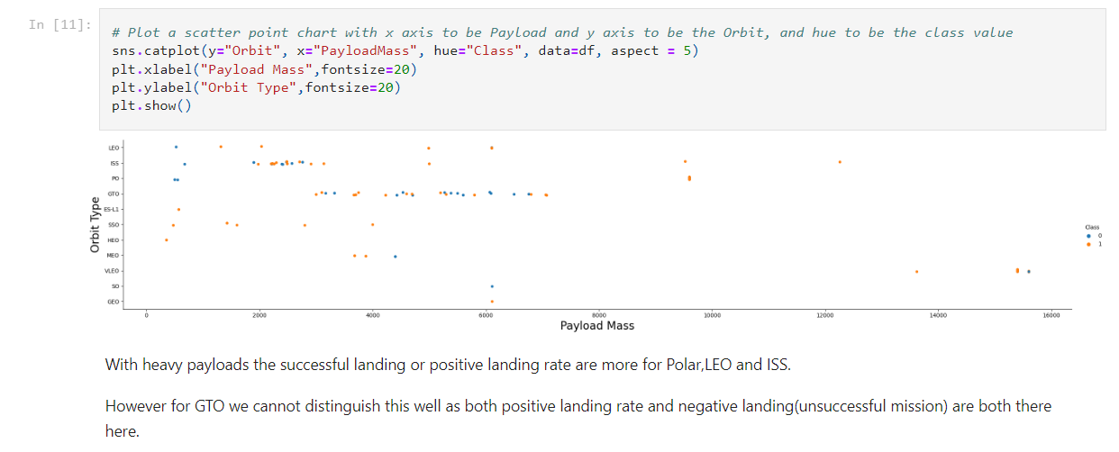
Payload vs. Orbit Type
Show a scatter plot of payload vs. orbit type
Show the screenshot of the scatter plot with explanations

Slide 29
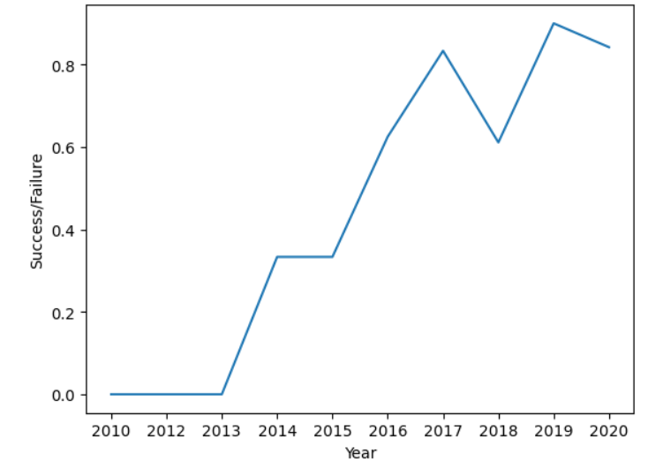
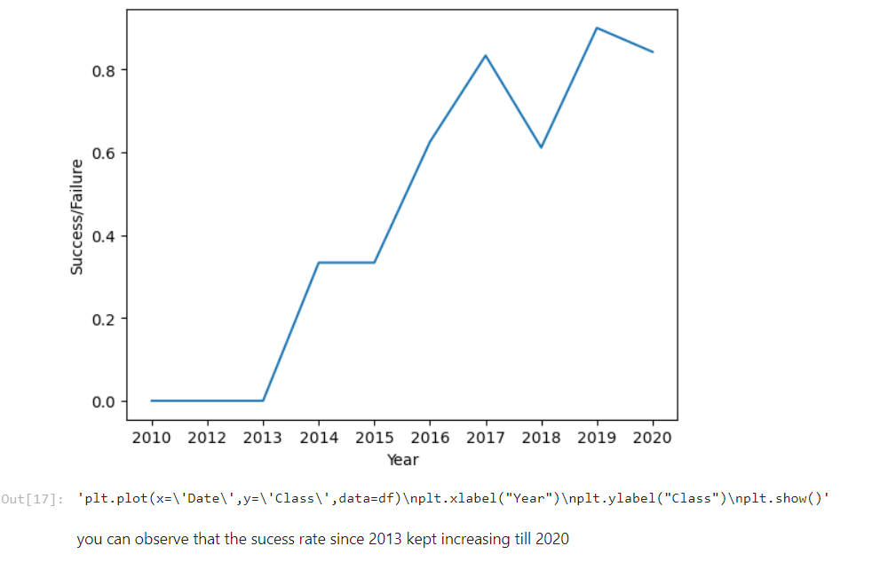
Launch Success Yearly Trend
Show a line chart of yearly average success rate
Show the screenshot of the scatter plot with explanations

Slide 30
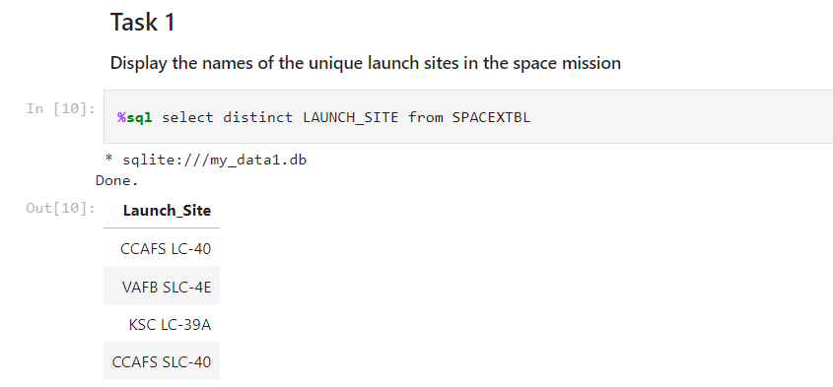
All Launch Site Names
Find the names of the unique launch sites

Slide 31
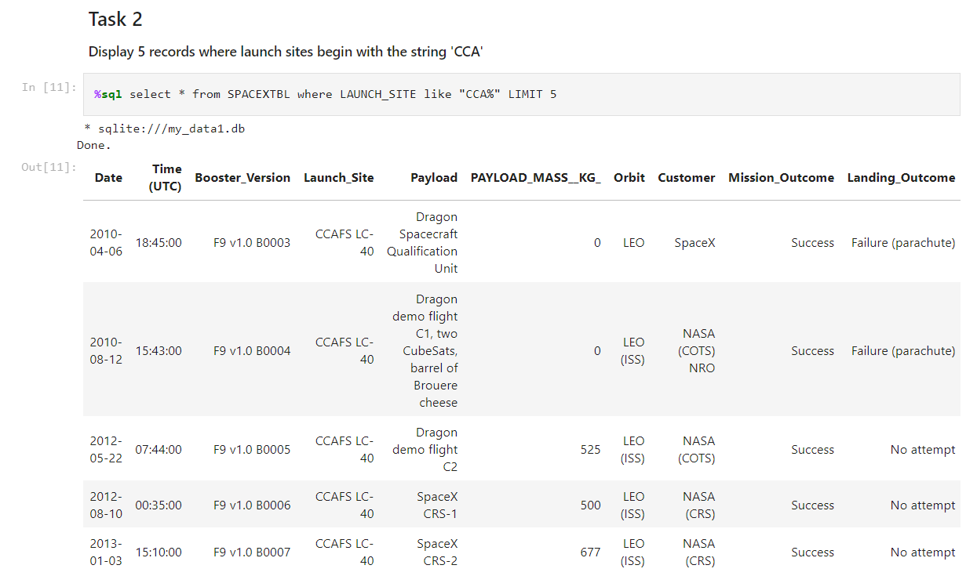
Launch Site Names Begin with 'CCA'
Find 5 records where launch sites begin with `CCA`

Slide 32
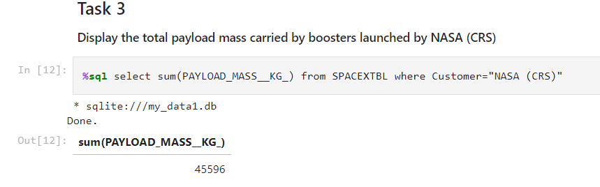
Total Payload Mass
Calculate the total payload carried by boosters from NASA

Slide 33
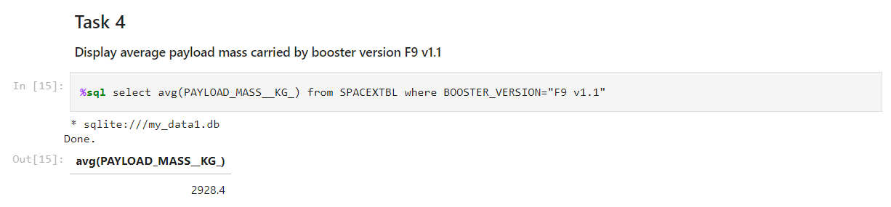
Average Payload Mass by F9 v1.1
Calculate the average payload mass carried by booster version F9 v1.1

Slide 34
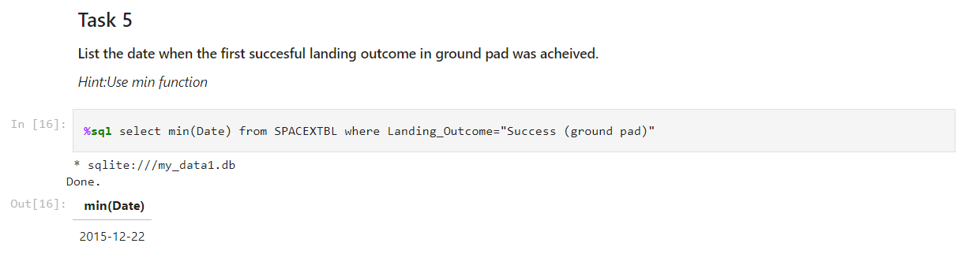
First Successful Ground Landing Date
Find the dates of the first successful landing outcome on ground pad

Slide 35
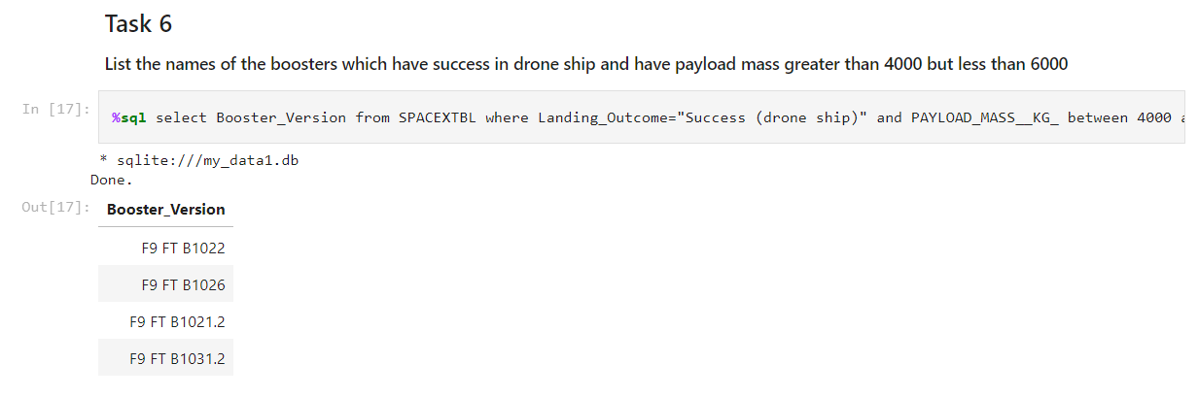
Successful Drone Ship Landing with Payload between 4000 and 6000
List the names of boosters which have successfully landed on drone ship and had payload mass greater than 4000 but less than 6000

Slide 36
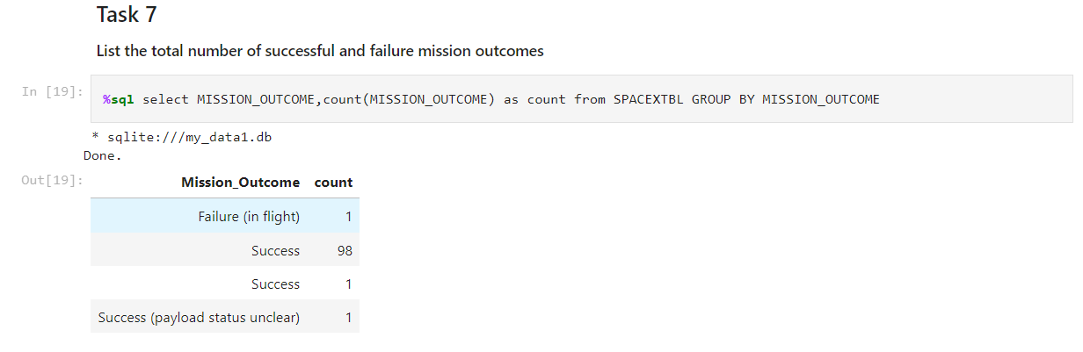
Total Number of Successful and Failure Mission Outcomes
Calculate the total number of successful and failure mission outcomes

Slide 37

Boosters Carried Maximum Payload
List the names of the booster which have carried the maximum payload mass

Slide 38

Section 3

Slide 39
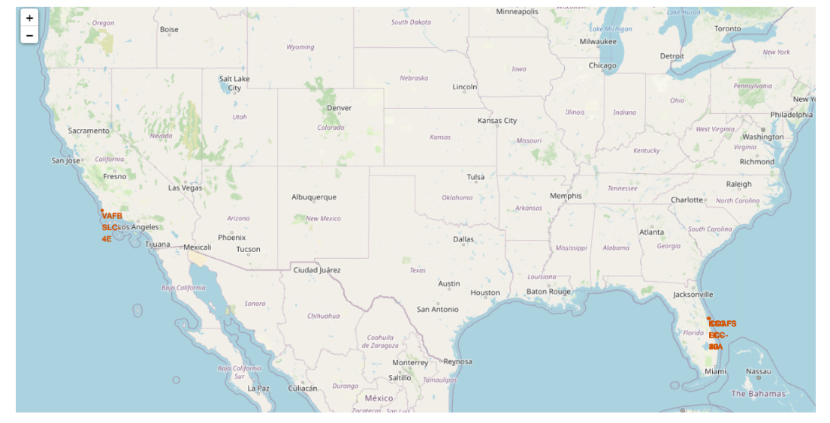
Generated Map with marked Launch Sites

Slide 40

Section 4

Slide 41
Classification Accuracy
A comparison of Training and Test Accuracy on KNN, Logistic Regression, Decision Tree and SVM.
Algorithm | Best Parameters using Grid Search Technique | Training Accuracy | Test Accuracy
Logistic Regression | {'C': 0.01, 'penalty': 'l2', 'solver': 'lbfgs'} | 0.846 | 0.833
SVM | {'C': 1.0, 'gamma': 0.03162277660168379, 'kernel': 'sigmoid'} | 0.848 | 0.833
Decision Tree | {'criterion': 'gini', 'max_depth': 18, 'max_features': 'sqrt', 'min_samples_leaf': 4, 'min_samples_split': 5, 'splitter': 'random'} | 0.875 | 0.833
KNN | {'algorithm': 'auto', 'n_neighbors': 10, 'p': 1} | 0.848 | 0.833

Slide 42
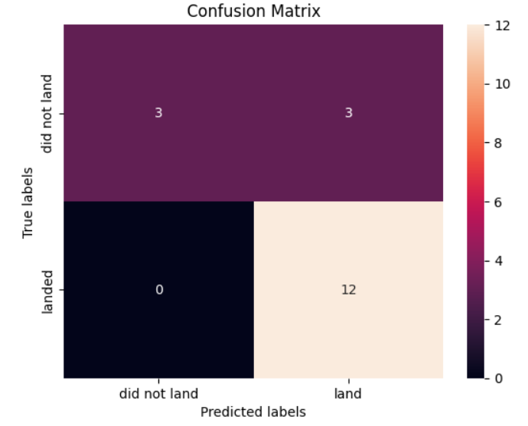
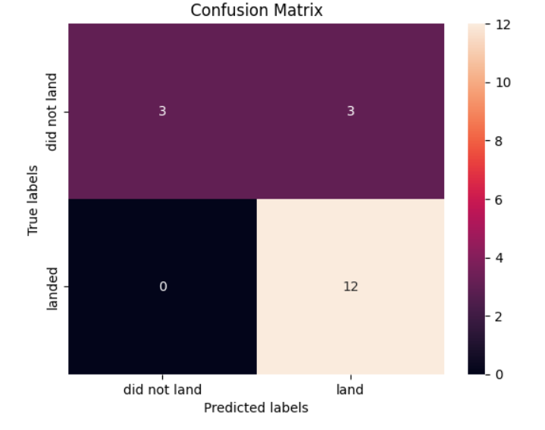
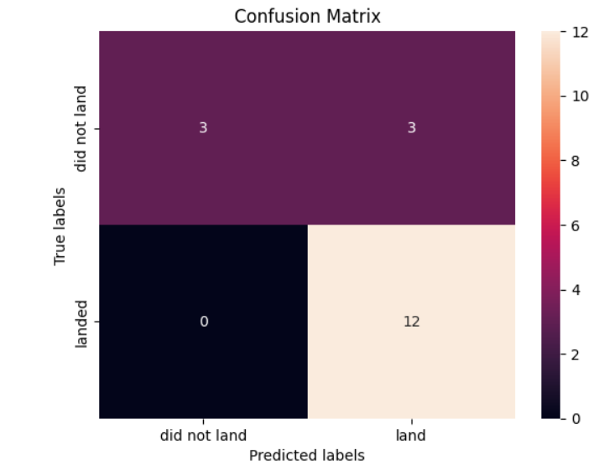

Confusion Matrix
Confusion Matrices of various algorithms
Logistic Regression SVM Decision Tree KNN

Slide 43
Conclusions
Decision Tree performs the best in terms of training accuracy whereas for the test data, all the algorithms- Logistic Regression, KNN, SVM and Decision Tree perform the same.
Different launch sites have different success rates. CCAFS LC-40, has a success rate of 60 %, while KSC LC-39A and VAFB SLC 4E has a success rate of 77%.
For the VAFB-SLC launchsite there are no rockets launched for heavypayload mass(greater than 10000). Low payloads perform better than the heavy ones.
Orbits ES-L1, GEO, HEO, SSO have higher success rates.
In the LEO orbit the Success appears related to the number of flights.
The success rate since 2013 kept increasing till 2020.

Slide 44


